Slide 1
Encapsulation and examples, Inheritance and Types, super keyword and super() method.
-SAYALI YADAV

Slide 2
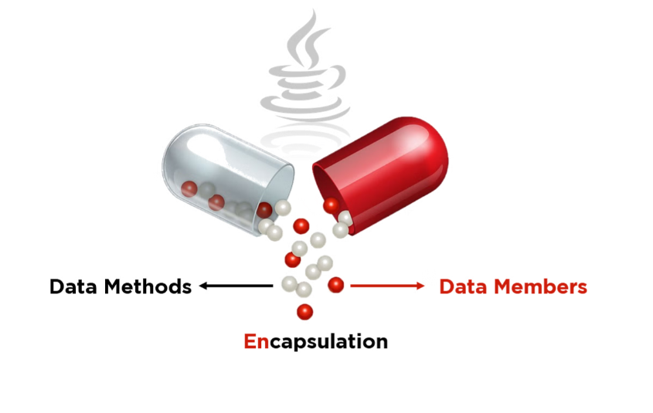
Encapsulation
Encapsulation in Java refers to integrating data (variables) and code (methods) into a single unit. In encapsulation, a class's variables are hidden from other classes and can only be accessed by the methods of the class in which they are found.
Encapsulation in Java refers to the bundling of data and methods that operate on the data within a single unit, typically a class. This concept helps in hiding the internal state of an object and only exposing necessary functionalities through methods. By encapsulating data, Java ensures better data security and code maintainability.

Slide 3
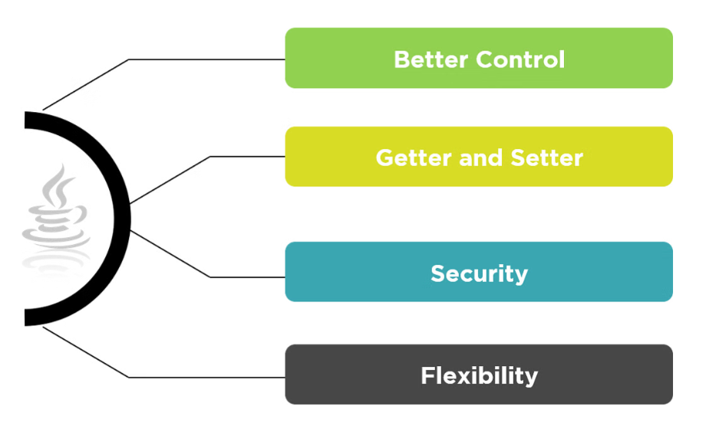
Need for Encapsulation in Java

Slide 4
class Area {
// fields to calculate area
int length;
int breadth;
// constructor to initialize values
Area(int length, int breadth) {
this.length = length;
this.breadth = breadth;
}
// method to calculate area
public void getArea() {
int area = length * breadth;
System.out.println("Area: " + area);
}
}class Main {
public static void main(String[] args) {
// create object of Area
// pass value of length and breadth
Area rectangle = new Area(5, 6);
rectangle.getArea();
}
}

Slide 5
Inheritance
Inheritance is another fundamental concept of Object-Oriented Programming (OOP).
It allows a new class (called a subclass or child class) to inherit properties and methods from an existing class (called a superclass or parent class).
This promotes code reusability and helps in building a relationship between classes, like "is-a" (a cat is an animal).
Types Of Inheritance:
1. Single Inheritance
2. Multilevel Inheritance
3. Hierarchical Inheritance
4. Multiple Inheritance
5. Hybrid Inheritance

Slide 6
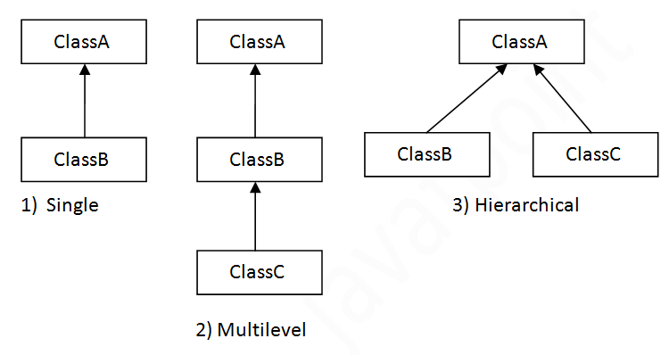
1. Single Inheritance
In single inheritance, a subclass inherits from one superclass.
class Vehicle {
void start() {
System.out.println("Vehicle starts");
}
}
class Car extends Vehicle { // Car inherits from Vehicle
void drive() {
System.out.println("Car drives");
}
}

Slide 7
2. Multilevel Inheritance
class Appliance {
void powerOn() {
System.out.println("Appliance powers on");
}
}
class WashingMachine extends Appliance {
void wash() {
System.out.println("Washing clothes");
}
}
class SmartWashingMachine extends WashingMachine {
void connectToWifi() {
System.out.println("Connecting to Wi-Fi");
}
}
In multilevel inheritance, a class is derived from another derived class (like a chain).

Slide 8
3. Hierarchical Inheritance
class Shape {
void draw() {
System.out.println("Drawing a shape");
}
}
class Circle extends Shape { // Circle inherits Shape
void calculateArea() {
System.out.println("Area of Circle");
}
}
class Square extends Shape { // Square inherits Shape
void calculateArea() {
System.out.println("Area of Square");
}
}
In hierarchical inheritance, multiple subclasses inherit from the same superclass.

Slide 9
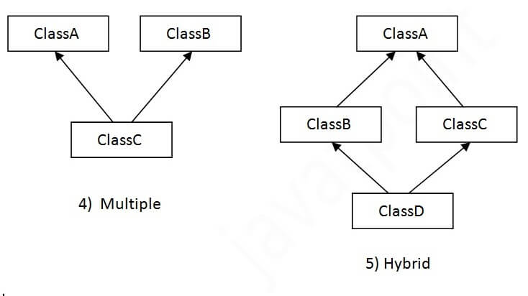
4. Multiple Inheritance
interface Playable {
void play();
}
interface Recordable {
void record();
}
class MediaPlayer implements Playable, Recordable { // MediaPlayer implements both Playable and Recordable
public void play() {
System.out.println("Playing media");
}
public void record() {
System.out.println("Recording media");
}
}
Multiple inheritance is when a class inherits from more than one class. Java doesn't support multiple inheritance with classes to avoid the Diamond Problem. However, it supports multiple inheritance through interfaces.

Slide 10
5. Hybrid Inheritance
class X {
public void disp() {
System.out.println("X");
}
}
class Y extends X {
public void disp() {
System.out.println("Y");
}
}
class Z extends X {
public void disp() {
System.out.println("Z");
}
}
public class W extends Y {
public void disp() {
System.out.println("W");
}
public static void main(String[] args) {
W obj = new W(); // Object of class W
obj.disp(); // Calls disp() method of class W
}
}
In general, the meaning of hybrid (mixture) is made of more than one thing. In Java, the hybrid inheritance is the composition of two or more types of inheritance. The main purpose of using hybrid inheritance is to modularize the code into well-defined classes. It also provides the code reusability.

Slide 11
Super Keyword
The super keyword can be used in three primary contexts:
To call the superclass constructor.
To access a method from the superclass that has been overridden in the subclass.
To access a field from the superclass when it is hidden by a field of the same name in the subclass.

Slide 12
class Animal {
void sound() {
System.out.println("Animal makes a sound");
}
}
class Dog extends Animal {
void sound() {
super.sound(); // Calls the sound() method of Animal class
System.out.println("Dog barks");
}
}
public class TestSuper {
public static void main(String[] args) {
Dog d = new Dog();
d.sound(); // Output: Animal makes a sound
// Dog barks
}
}
class Animal {
String color = "White";
}
class Dog extends Animal {
String color = "Black";
void displayColor() {
System.out.println("Dog's color: " + color); // Refers to the child class variable
System.out.println("Animal's color: " + super.color); // Refers to the parent class variable
}
}
public class Main {
public static void main(String[] args) {
Dog dog = new Dog();
dog.displayColor();
}
}

Slide 13
Super() Statement
Key Points About super():
It must be the first statement in the child class constructor.
Used to invoke the parent class constructor, either the default constructor or a parameterized one.
If a parent class has a parameterized constructor and no default constructor, you must explicitly use super() to call the appropriate constructor.
If not called explicitly, Java will automatically call the no-argument constructor of the parent class (if it exists).

Slide 14
class Animal {
Animal(String type) {
System.out.println("Animal constructor called: " + type);
}
}
class Dog extends Animal {
Dog(String name) {
super("Dog"); // Calls the parameterized constructor of the parent class
System.out.println("Dog constructor called: " + name);
}
}
public class Main {
public static void main(String[] args) {
Dog dog = new Dog("Buddy"); // Calls Animal constructor first, then Dog constructor
}}

